Slide 1
Fixing the Accelerator Time Structure
Ken Andersen
Instruments Division Head Science Directorate
ESS Science Advisory Committee
Lund 2010-11-04

Slide 2
Accelerator Time Structure
Reference parameters:
Pulse length τ=2ms
Repetition period T=60ms
Time-integrated power =5MW
Effect on the accelerator
What are the basic technical limits to high power?
Risk/performance balance
What is our envisaged upgrade path?
F.Mezei with ESS accelerator team
Effect on the instruments
Choose reasonable instrument suite
Evaluate their performance as a function of time structure
K.Lefmann with Copenhagen McStas team
Time structure needs to be fixed by March 2011

Slide 3
Power calculation
For good day 1 reliability, I<50mA
Scope for increasing this 5-10 years into operation
Cannot increase peak power

Slide 4
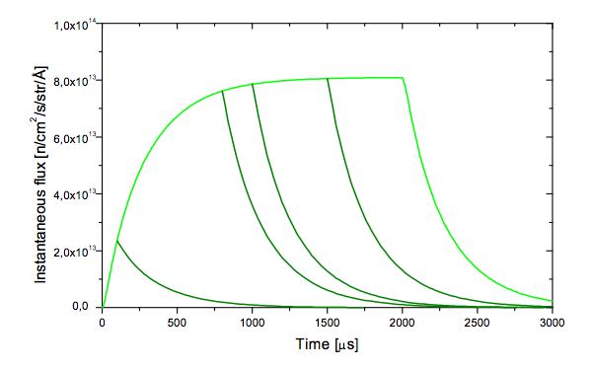
Shorten pulse length and T
Cold Moderator λ=4Å
feasible
Peak flux roughly constant for τ>1ms
Loss in Time-average flux is faster than linear
Loss of plateau region

Slide 5
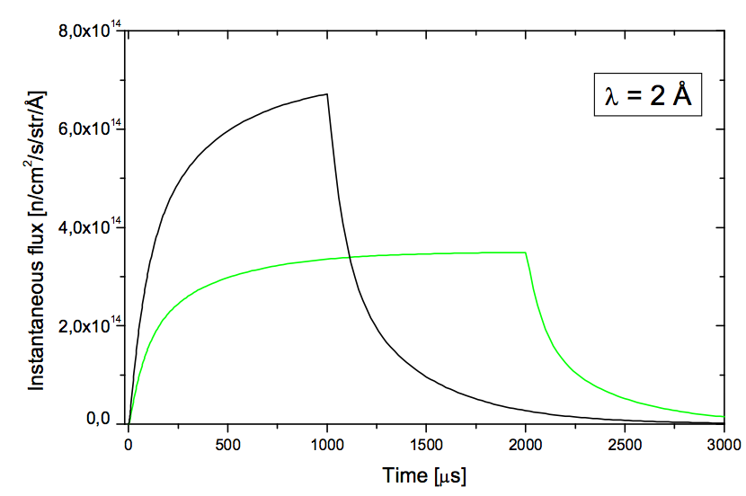
Halve pulse length, maintain T
Thermal Moderator λ=2Å
not feasible
Gain in Peak flux less than linear
Loss of plateau region

Slide 6
Accelerator boundary conditions
With 5MW and 50mA as boundary conditions:
no scope for reducing pulse length
no scope for reducing rep rate
How hard should we push to go beyond those boundary conditions?
depends on impact on accelerator reliability and on instrument performance

Slide 7
Effect on the instruments
Establish a reasonable instrument suite:
Spectrometers: cold chopper, thermal chopper, cold TAS, thermal TAS, TOF-TAS, 10μeV backscattering
Spin-echo: solenoid (IN11) type, Wide-angle (Span) type
Diffractometers: cold powder, thermal powder, extreme environment single crystal
LSS: Short SANS, medium SANS, long SANS, vertical reflectometer, horizontal reflectometer
Vary time structure and optimise each instrument for each time structure
Huge job: 14 simulators over 10 months!
Figure of Merit = flux at sample over useful divergence ×λ^{α}
α=0 for spectrometers and diffractometers
α=2-4 for other instruments

Slide 8
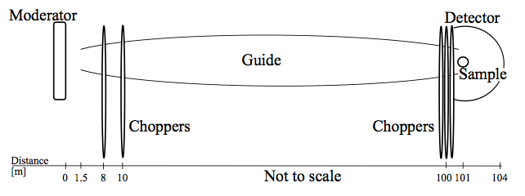
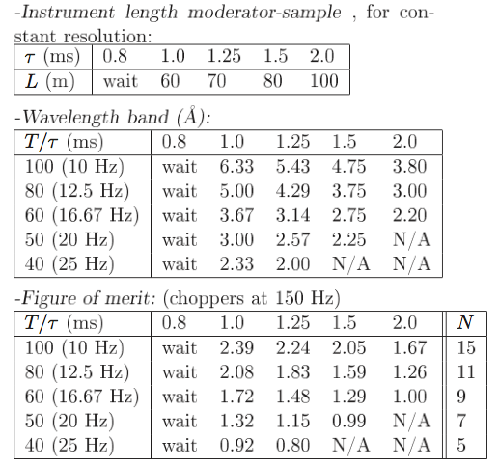
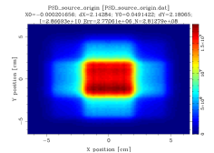
Optimisation example: Cold chopper
elliptical guide
Sample 2×2cm²
Make full use of RRM
100m long for τ=2ms
For shorter τ, reduce length to keep resolution constant at 1.6% at 5Å

Slide 9
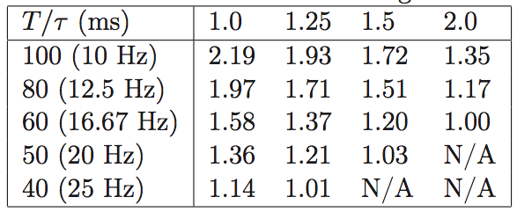
Keeping 5MW time-average power

Slide 10
Keeping 5MW time-average power
120mA
60mA
×1.58

Slide 11
Keeping 5MW time-average power
200mA
×1.61
100mA

Slide 12
Keeping 5MW time-average power
200mA
×1.61
100mA

Slide 13
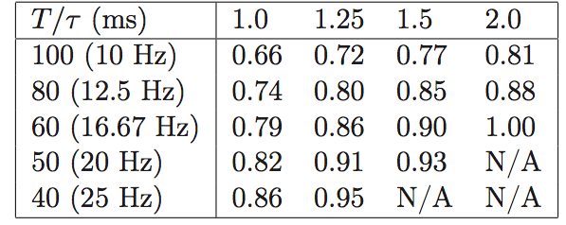
Keeping 60mA peak current

Slide 14
Keeping 60mA peak current
2.5MW
5MW
×1.27

Slide 15
Keeping 60mA peak current
1.5MW
×1.24
3MW

Slide 16
Keeping 60mA peak current
1.5MW
×1.24
3MW

Slide 17
Effect on the instruments
Instruments which can take full advantage of time structure will scale with the peak flux
Instruments which might as well be on a steady-state source will scale with the time-average flux
Conclusions:
These instruments are, on average, fairly well suited to a pulsed source
Therefore, the main performance criterion is the peak flux
The detailed time structure is less important
Not a strong case to push the accelerator guys for a different time structure

Slide 18
Thank you to all involved!
Ken Andersen
Instruments Division Head Science Directorate
ESS Science Advisory Committee
Lund 2010-11-04

